Slide 1
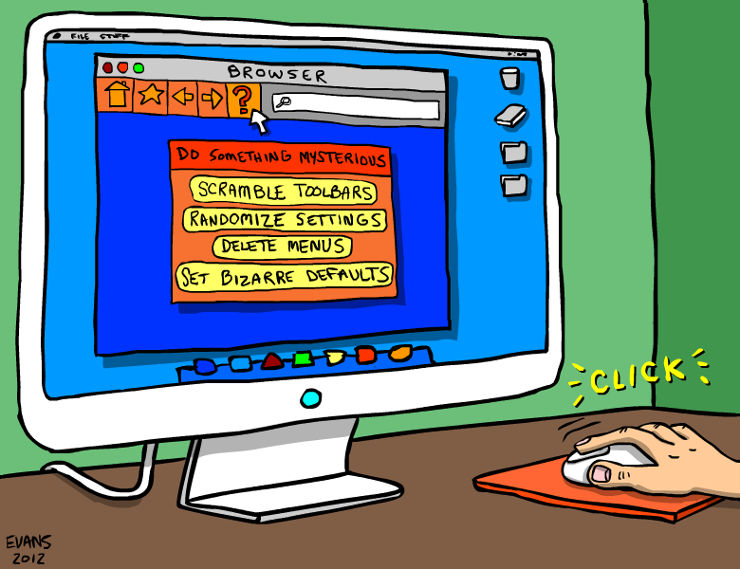
Java Programming
Graphic User Interface
图形用户界面

Slide 2
Outline
Create your 1st GUI program
Java GUI APIs
Java GUI programming
Containers & Components
JFrame/Jpanel/Jbutton/JLabel/JTextField/JTextArea/JScrollPane
Layout Managers
Event-Driven programming
Event source/Event trigger/Event listener/Event handling
Dialog
Menu

Slide 3
Creating your 1st GUI program

Slide 4
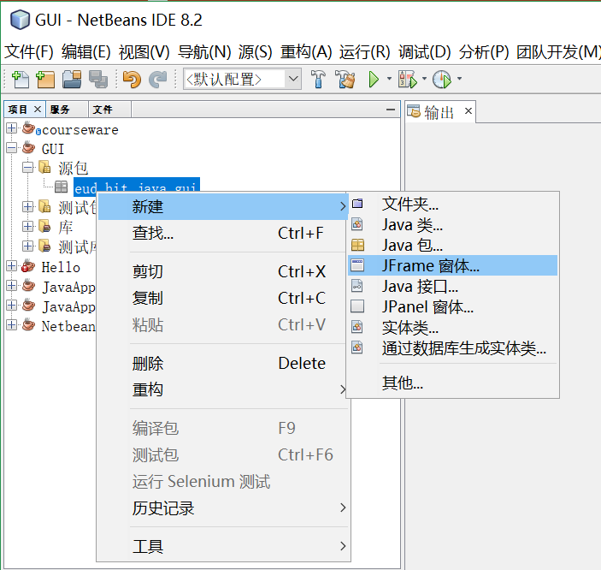
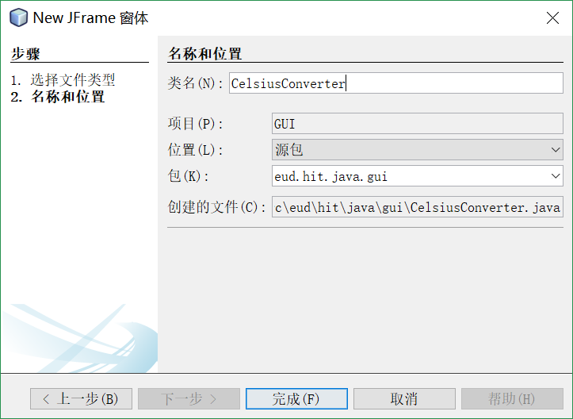
Creating 1st GUI Application
的

Slide 5
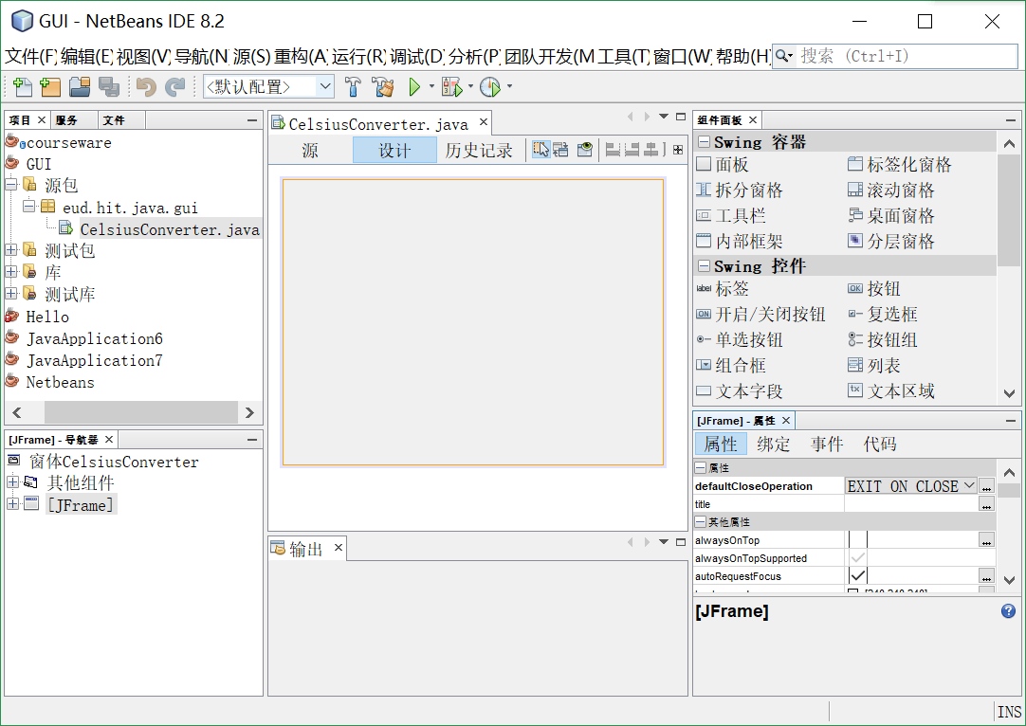
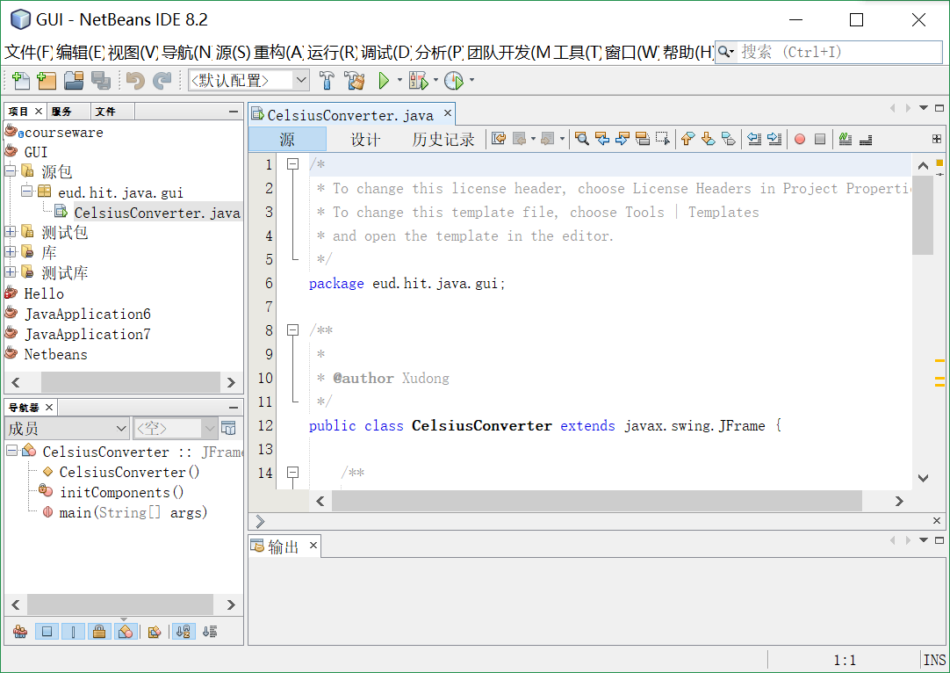
Code are generated automaticly
我

Slide 6
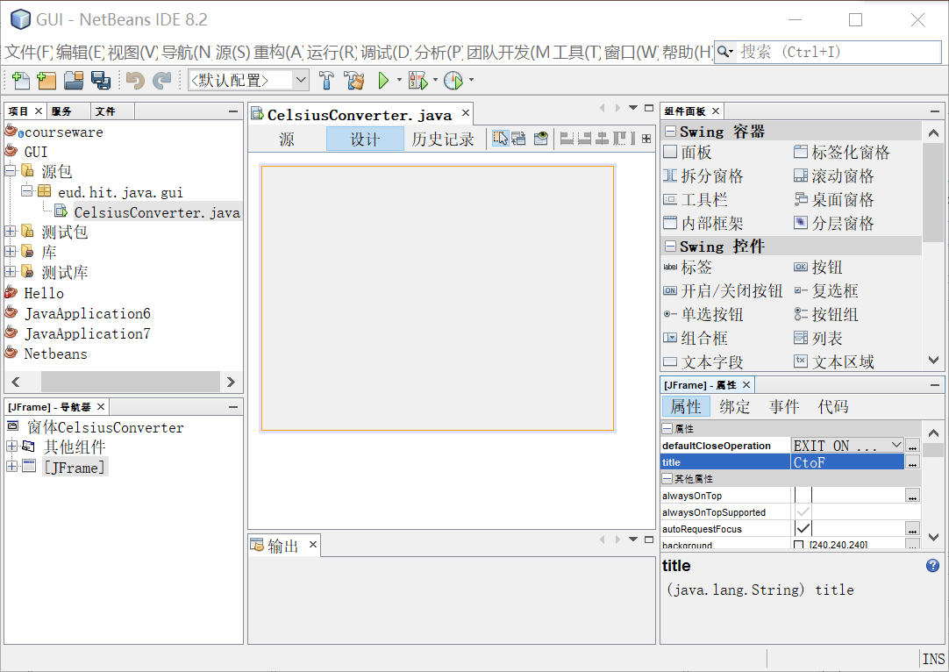
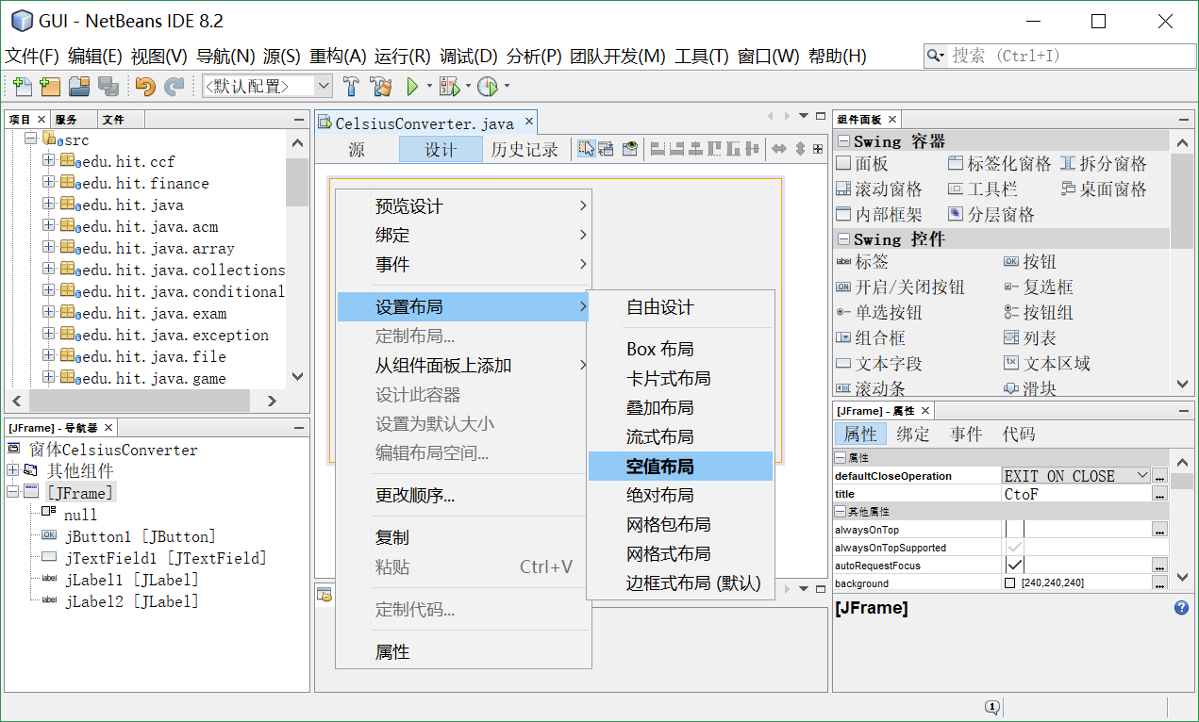
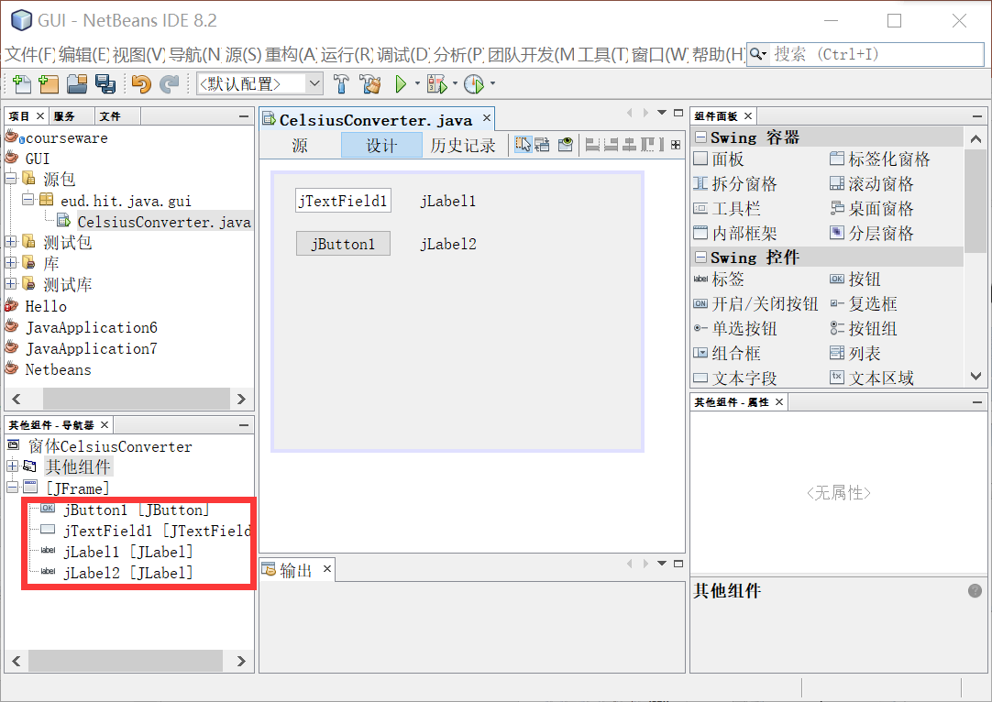
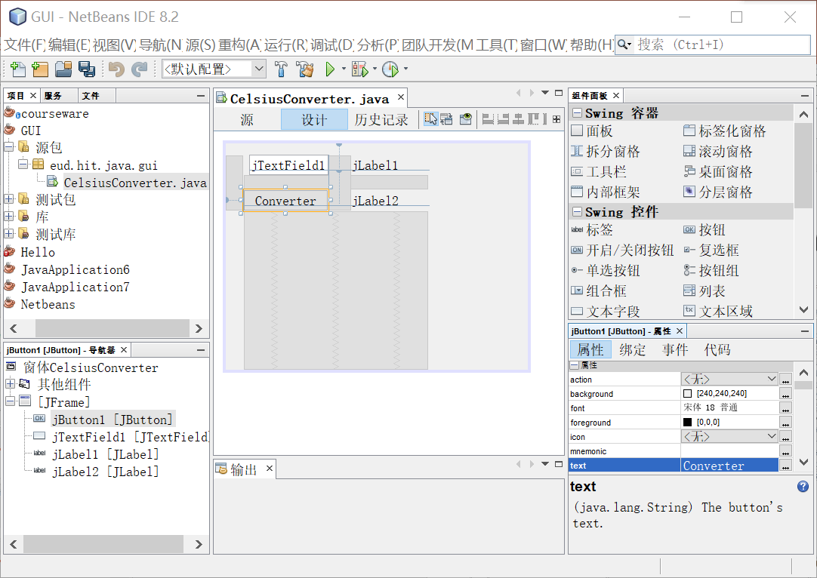
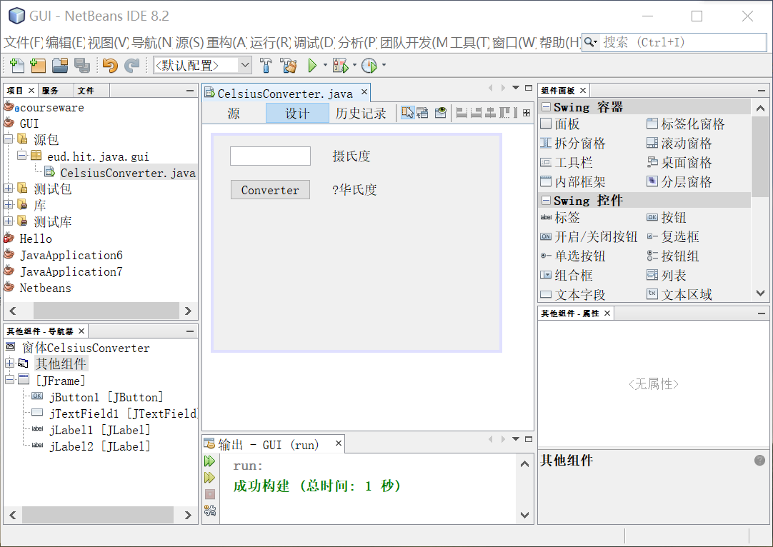
Designing GUI
Notes:
1 修改窗口标题CtoF
2

Slide 7
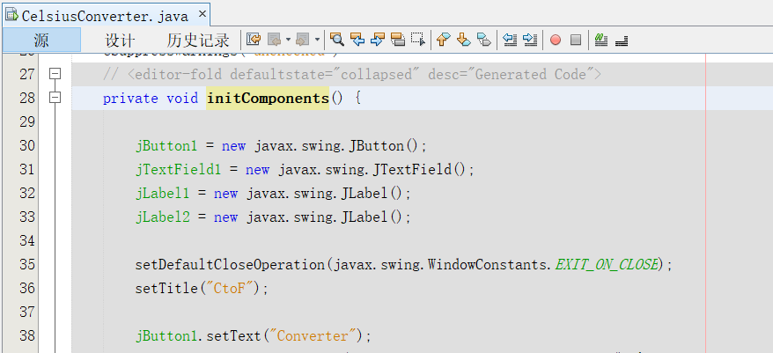
More code are generated
Notes:
Netbeans中灰色代码不可修改

Slide 8
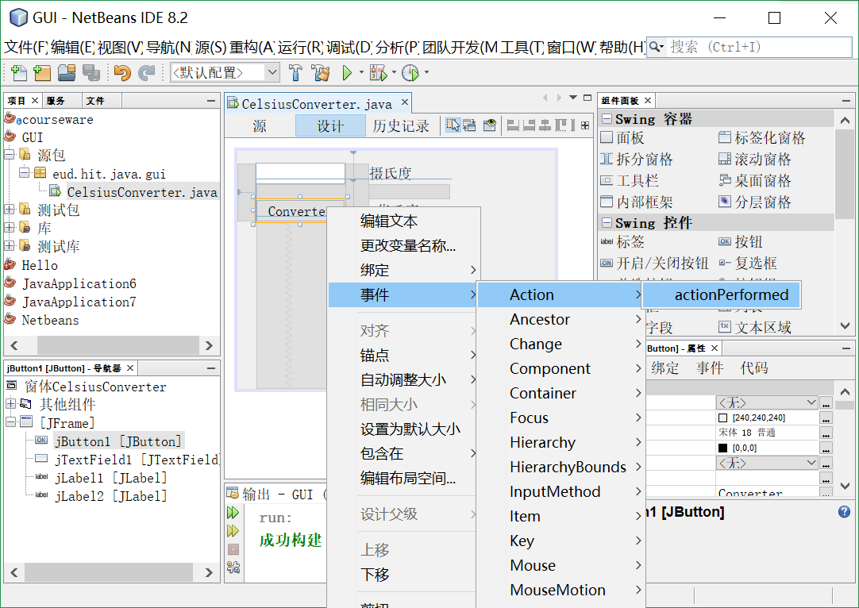
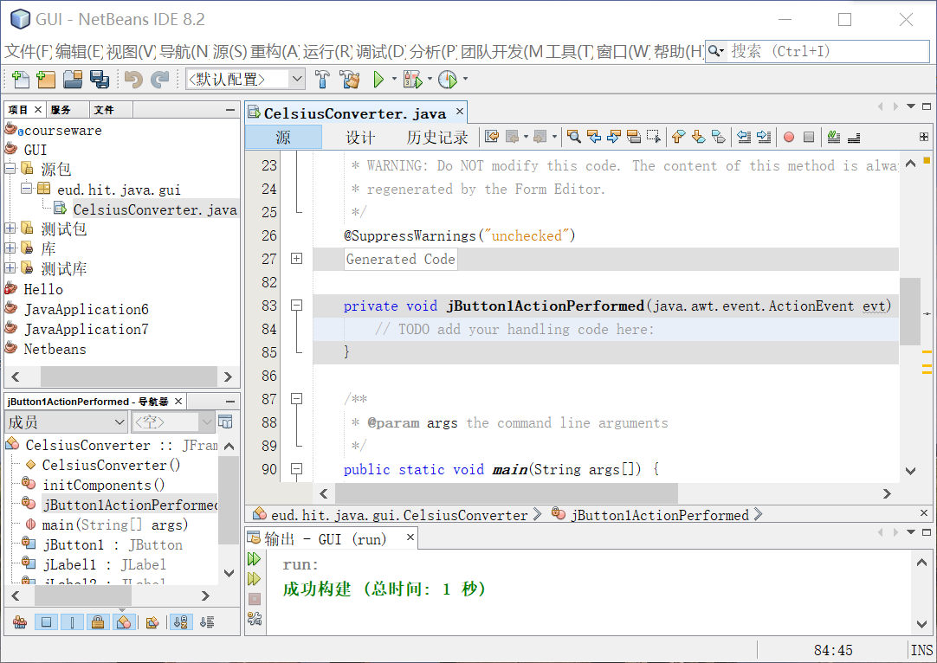
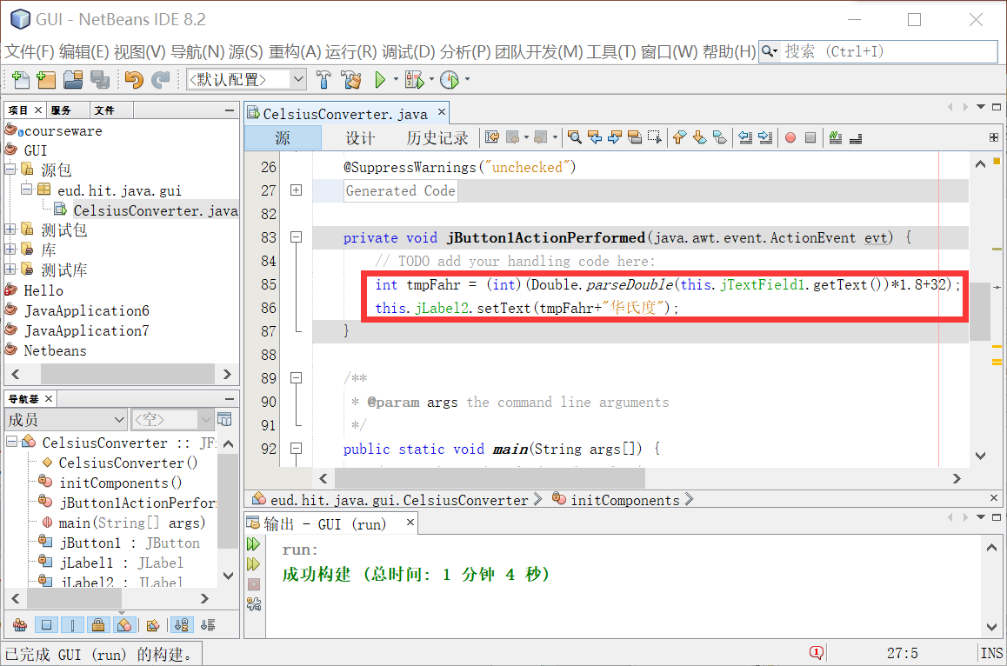
Write your own code

Slide 9
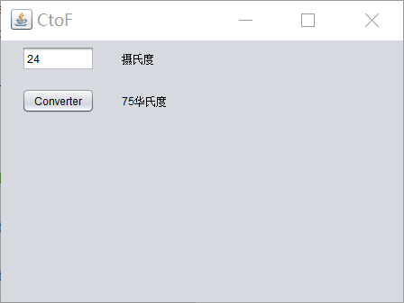
Run your 1st GUI application

Slide 10
Java GUI APIs
There are three sets of Java APIs for GUI programming:
AWT (Abstract Windowing Toolkit)
introduced in JDK 1.0.
have become obsolete and should be replaced by newer Swing components.
Swing
Swing is part of Java Foundation Classes (JFC) after the release of JDK 1.1.
Some legacy AWT classes (in package java.awt.event) are still used in Swing!
JavaFX
JavaFX is a set of graphics and media packages that enables developers to design, create, test, debug, and deploy rich client applications that operate consistently across diverse platforms.
Other GUI APIs that work with Java
SWT (Eclipse's Standard Widget Toolkit) (used in Eclipse),
GWT (Google Web Toolkit) (used in Android),
…

Slide 11
Swing
Swing is part of the so-called “Java Foundation Classes (JFC)”. JFC consists of:
Swing API: for advanced graphical programming.
Accessibility API: provides assistive technology for the disabled.
Java 2D API: for high quality 2D graphics and images.
Pluggable look and feel supports.
Drag-and-drop support between Java and native applications.

Slide 12
Swing
Swing is huge (consists of 18 API packages as in JDK 1.7) and has great depth.
The main features of Swing are:
pure Java
Lightweight
pluggable look-and-feel
supports mouse-less operation
…

Slide 13
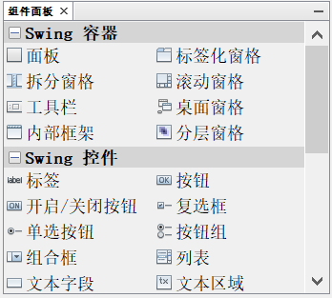
Components(控件)
Swing provides a huge and comprehensive collection of reusable GUI components.

Slide 14
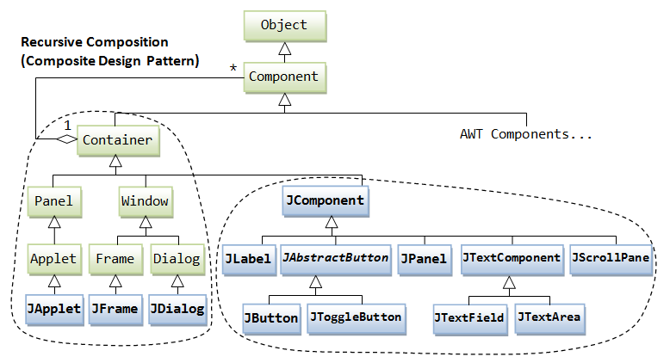
Containers(容器)
Besides the components, there are another group of classes: containers. A container is used to hold components. A container can also hold containers because it is a (subclass of) component.

Slide 15
Containers
Top-Level and Secondary Containers
Top-Level Containers
JFrame, used for the application's main window
JDialog: used for secondary pop-up window
JApplet: used for the applet's display-area
Secondary Containers (Content-Pane)
Jpanel: used to group and layout relevant components.
Notice:
the JComponents shall not be added onto the top-level container!
The JComponents must be added onto the so-called content-pane of the top-level container!

Slide 16
JFrame & JPanel
A JFrame has a title bar (containing an icon, a title, and the minimize/maximize/close buttons), an optional menu bar and the content display area (also called content pane).
The content pane is a JPanel which is a rectangular area used to group related GUI components in a certain layout.
You can use the add() method of the JPanel to assemble the GUI components.

Slide 17
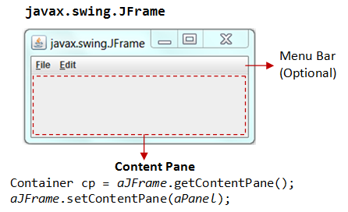
The content-pane
Two ways to get the content-pane
Get the content-pane via getContentPane() from a top-level container, and add components onto it.
If a component is added directly into a JFrame, it is added into the content-pane of JFrame instead
Create a JPanel and set it as the content-pane via JFrame's setContentPane().

Slide 18
Getting the content-pane
public class TestGetContentPane extends JFrame {
// Constructor
public TestGetContentPane() {
// Get the content-pane of this JFrame, which is a java.awt.Container
// All operations, such as setLayout() and add() operate on the content-pane
Container cp = this.getContentPane();
cp.setLayout(new FlowLayout());
cp.add(new JLabel("Hello, world!"));
cp.add(new JButton("Button"));
......
}
.......
}

Slide 19
Setting the content-pane
public class TestSetContentPane extends JFrame {
// Constructor
public TestSetContentPane() {
// The "main" JPanel holds all the GUI components
JPanel mainPanel = new JPanel(new FlowLayout());
mainPanel.add(new JLabel("Hello, world!"));
mainPanel.add(new JButton("Button"));
// cof this JFrame to the main JPanel
this.setContentPane(mainPanel);
......
}
.......
}

Slide 20
Layout Managers(布局管理器)
A container has a so-called layout manager to arrange its components.
The layout managers provide a level of abstraction to map your user interface on all windowing systems, so that the layout can be platform-independent.
A container has a setLayout() method to set its layout manager.

Slide 21
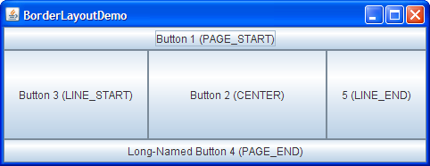
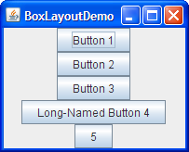
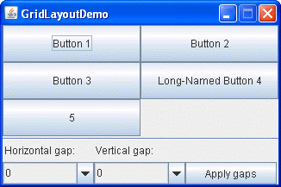
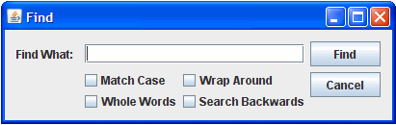
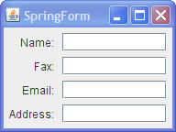

Some Layout Managers
BoxLayout
BorderLayout
GroupLayout
GridLayout
FlowLayout
SpringLayout
Notes:
https://docs.oracle.com/javase/tutorial/uiswing/layout/visual.html

Slide 22
FlowLayout
FlowLayout is the default layout manager for every JPanel.
It simply lays out components in a single row, starting a new row if its container is not sufficiently wide.
The row is, by default, centered horizontally within the container.
http://docs.oracle.com/javase/tutorial/uiswing/layout/visual.html

Slide 23
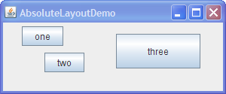
Without a Layout Manager(Absolute Positioning)
If a container holds components whose size is not affected by the container’s size or by font, look-and-feel, or language changes, then absolute positioning(绝对布局) might make sense.
Each component as a setBounds() method to set the absolute position on the content pane.

Slide 24
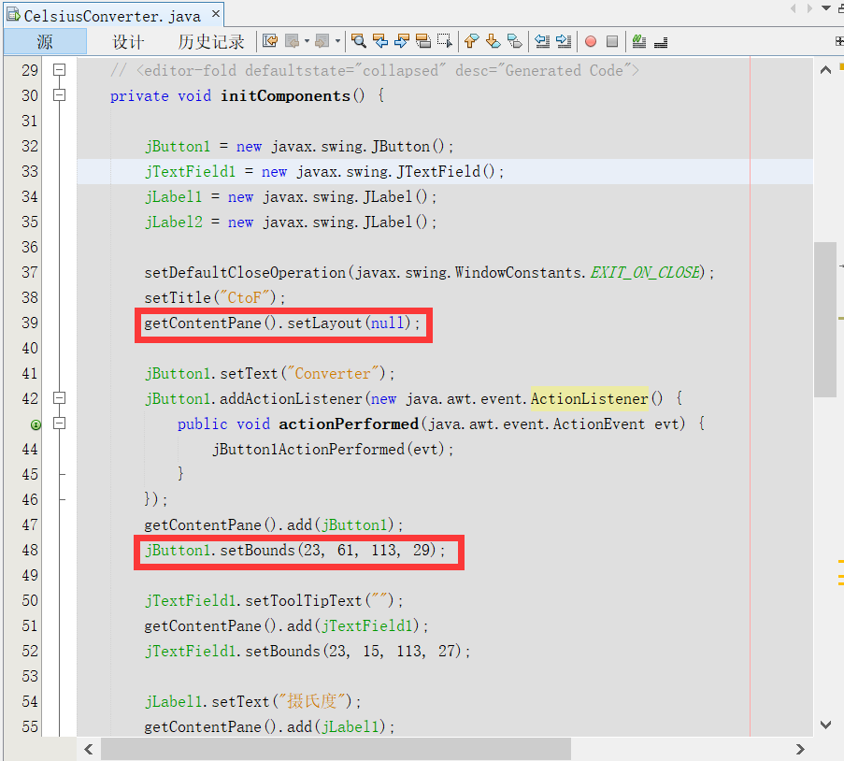
Without a Layout Manager
Creating a container without a layout manager involves the following steps.
Set the container's layout manager to null by calling setLayout(null).
Call the Component class's setbounds method for each of the container's children.
Call the Component class's repaint method.
Note: if you use WYSWYG GUI Builder, such as, windowbuilder in Eclipse, theses code are generated automatically.

Slide 25
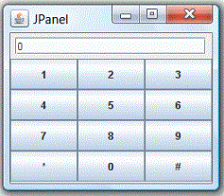
Layout with panel
Panels can be used to organize a group of related components.
For example, the following figure shows a Frame (in BorderLayout) containing two Panels,
panelResult in FlowLayout and panelButtons in GridLayout.
panelResult is added to the NORTH, and panelButtons is added to the CENTER.

Slide 26

Event-Driven programming
Java adopts the so-called “Event-Driven” (事件驱动) programming model for GUI programming.
In event-driven programming, a piece of event-handling codes is called back (invoked implicitly) by the graphics subsystem when an event has been fired in response to an user input (such as clicking a mouse button or hitting the ENTER key).
This is unlike the procedural model, where codes are executed in a sequential manner.

Slide 27
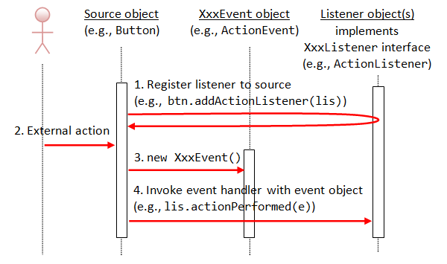
Event-Handling(事件处理)
Three objects are involved in the event-handling: a source, listener(s) and an event object.
Notes:
除了第1步为程序员编程实现，第2，3，4等步骤有GUI系统实现，对程序员不可见，隐式调用listener的actionPerflormed方法

Slide 28
Event-Handling
Register listener(s) to the event source object (such as JButton and JTextfield)
The event source object interacts with the user.
Upon triggered, it creates an event object.
This event object will be messaged to all the registered listener object(s), and an appropriate event-handler method of the listener(s) is called-back to provide the response.
Notes:
In other words, triggering a source fires an event to all its listener(s), and invoke an appropriate handler of the listener(s).

Slide 29
Event trigger(事件触发者)
The trigger may be user, who may interact with the software by way of, for example, keystrokes on the keyboard.
Another trigger may be hardware devices such as timer.
Software can also trigger its own set of events

Slide 30
Event(事件)
Swing use the XXXEvent classes which belong to AWT (in package java.awt.event).
For example,
clicking an Button fires an ActionEvent,
mouse-click fires MouseEvent,
key-type fires KeyEvent, etc.

Slide 31
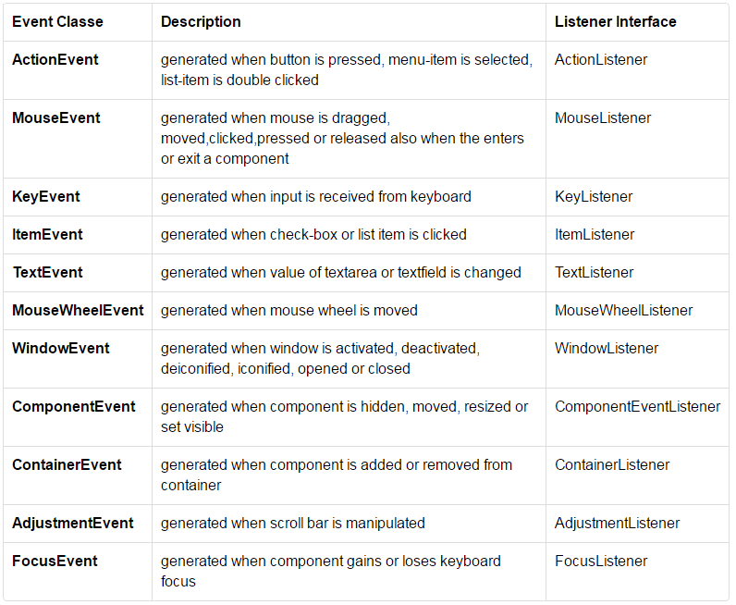
Event

Slide 32
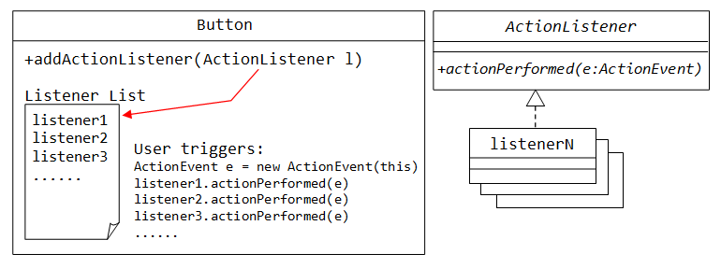
Event Listener(事件监听器)
We need to implement XXXListener interfaces to response to these events appropriately.
The source object then registers listener object via the addXxxListener() method.

Slide 33
Event Listener
In general, we use anonymous inner class to implement the event listener interfaces.
Sometimes, we register two or more listeners to the same event source.
When an event are fired, more than one listeners can be revoked to response the event.

Slide 34
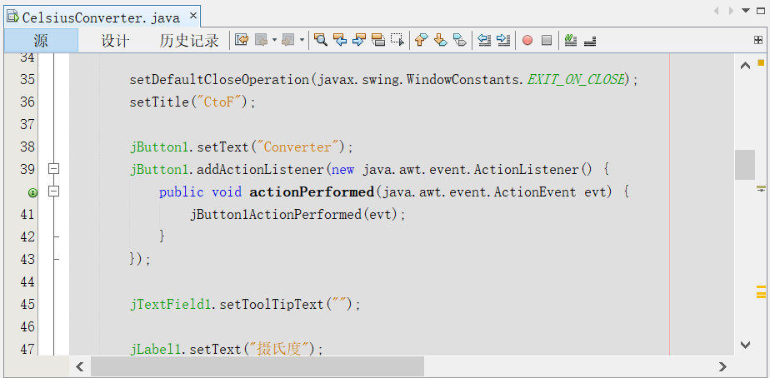
Event Listener
jButton1.addActionListener(new java.awt.event.ActionListener() {
public void actionPerformed(java.awt.event.ActionEvent evt) {
jButton1ActionPerformed(evt);
}
});
private void jButton1ActionPerformed(java.awt.event.ActionEvent evt) {
// TODO add your handling code here:
int tmpFahr = (int)(Double.parseDouble(this.jTextField1.getText())*1.8+32);
this.jLabel2.setText(tmpFahr+"华氏度");
}

Slide 35
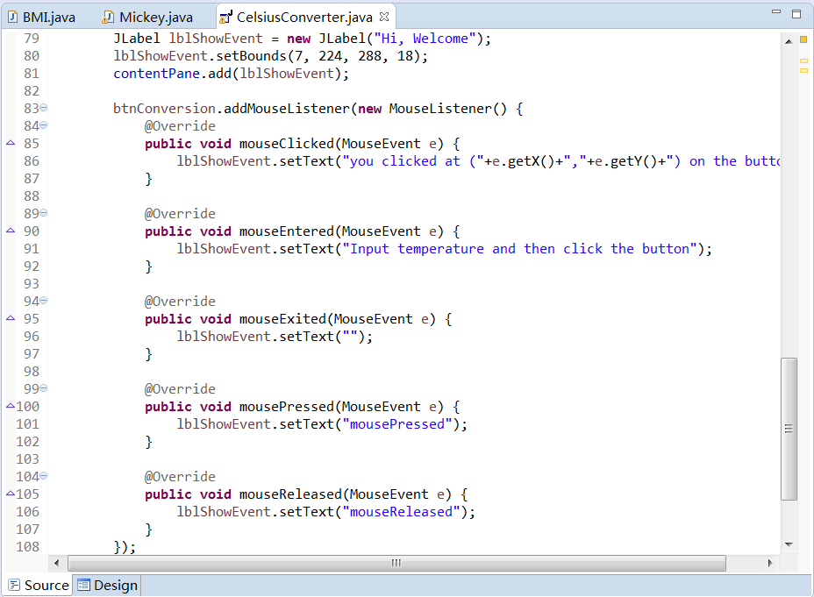
Event Listener

Slide 36
Dialog(对话框)
If user did not input the Celsius temperature, there will be an error, how to alert user to avoid this error.
JOptionPane makes it easy to pop up a standard dialog box that prompts users for a value or informs them of something.
Method Name | Description
showConfirmDialog | Asks a confirming question, like yes/no/cancel.
showInputDialog | Prompt for some input.
showMessageDialog | Tell the user about something that has happened.
showOptionDialog | The Grand Unification of the above three.
http://docs.oracle.com/javase/7/docs/api/javax/swing/JOptionPane.html
Notes:
http://docs.oracle.com/javase/tutorial/uiswing/components/dialog.html

Slide 37
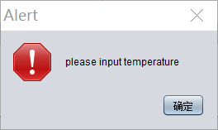
Dialog
private void jButton1ActionPerformed(java.awt.event.ActionEvent evt) {
// TODO add your handling code here:
String s = this.jTextField1.getText();
if (s == null || s.equals("")) {
JOptionPane.showMessageDialog(null,
"please input temperature", "Alert",
JOptionPane.ERROR_MESSAGE);
return;
}
int tmpFahr = (int) (Double.parseDouble(s) * 1.8 + 32);
this.jLabel2.setText(tmpFahr + "华氏度");
}

Slide 38
Menu(菜单)
As mentioned above, a JFrame has a title bar, an optional menu bar and the content-pane.
To create a menu-bar, construct a JMenuBar. The menu-bar is set via the JFrame's setJMenuBar() method.
A menu-bar (JMenuBar) contains menu (JMenu). A menu contains menu-item (JMenuItem). You can use the add() method of the components to assemble the menu bar.
Similar to Jbutton, you can response the ActionEvent via the JMenuItem’s addActionListener() method.

Slide 39
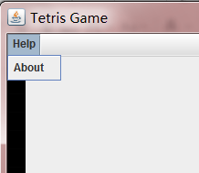
Menu
…
JMenuBar menu = new JMenuBar();
JMenu helpMenu = new JMenu("Help");
JMenuItem aboutitem = new JMenuItem("About ");
aboutitem.addActionListener( new ActionListener() {
public void actionPerformed(ActionEvent e) {
//do something
}
});
helpMenu.add(aboutitem);
menu.add(helpMenu);
frame.setJMenuBar(menu);
…

Slide 40
Demo

Slide 41
BMI Statistics
How to show the different GUIs?
How to show the students ?
How to input the information of a student?
How to delete a student?
How to modify a student?

Slide 42
How to show the different GUIs?
public class GUIBMI extends JFrame {
…
JMenuBar menu = new JMenuBar();
JMenu opMenu = new JMenu("Operations");
JMenuItem listitem = new JMenuItem("List students");
listitem.addActionListener(new ActionListener() {
public void actionPerformed(ActionEvent e) {
showStudetns();
}
});
opMenu.add(listitem);
…
private void showStudetns(){…}
…
}

Slide 43
private void showStudetns(){
this.setContentPane(new resultPanel());
setVisible(true);
}

Slide 44
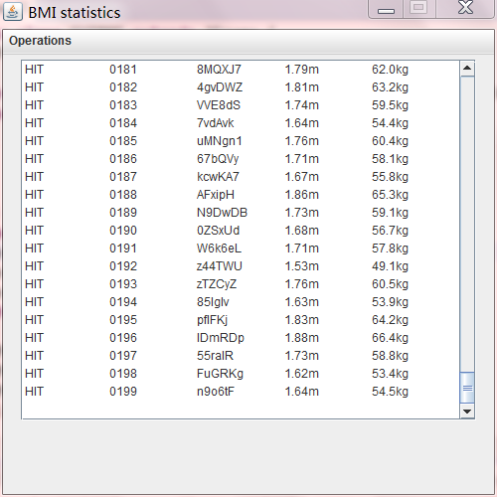
Showing the students
JTextArea
JScrollPane

Slide 45
Showing the students
class resultPanel extends JPanel{
public resultPanel() {
JTextArea ta= new JTextArea("",20,40);
ArrayList<Student> alst= Student.genTestStudents();
StringBuffer sb = new StringBuffer();
for(Student st: alst){
sb.append(st.toString()).append("\n");
}
ta.setText(sb.toString());
ta.setEditable(false);
JScrollPane sp=new JScrollPane(ta);
sp.setBounds(5, 5, 500, 300);
sp.setVerticalScrollBarPolicy(JScrollPane.VERTICAL_SCROLLBAR_AS_NEEDED);
this.add(sp);
}
}

Slide 46


